Slide 1

Dthreads: Efficient Deterministic Multithreading
Insanity: Doing the same thing over and over again and expecting different results.
Tongping Liu, Charlie Curtsinger, Emery Berger

Slide 2
In the Beginning…
Notes:
In the beginning, there was the Core. And it was good.

Slide 3
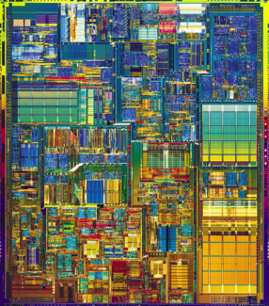
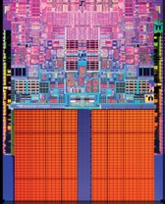
There was the Core.

Slide 4
And it was Good.

Slide 5
It gave us our Daily Speed.

Slide 6

Until the Apocalypse.

Slide 7
And the Speed was no Moore.

Slide 8
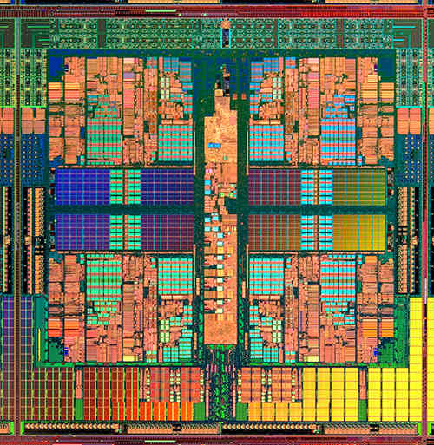
And then came a False Prophet…

Slide 9

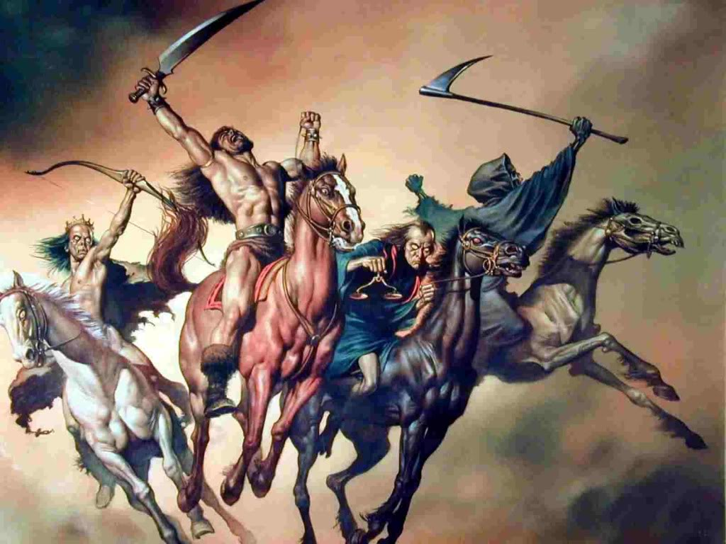

Slide 10

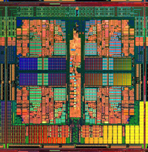
Want speed?

Slide 11
I BRING YOU THE GIFT OF PARALLELISM!

Slide 12
color = ; row = 0; // globals
void nextStripe(){
for (c = 0; c < Width; c++)
drawBox (c,row,color);
color = (color == )?  : ; row++;
}
for (n = 0; n < 9; n++)
pthread_create(t[n], nextStripe);
for (n = 0; n < 9; n++)
pthread_join(t[n]);
JUST USE THREADS…

Slide 18
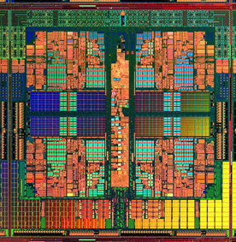
race conditions
pthreads
atomicity violations
deadlock
order violations

Slide 19


Salvation?

Slide 21

Dthreads
race conditions
race conditions
atomicity violations
pthreads
atomicity violations
Dthreads
deadlock
deadlock
order violations
order violations
deterministic
Notes:
Casts out the demons of nondeterminism

Slide 22



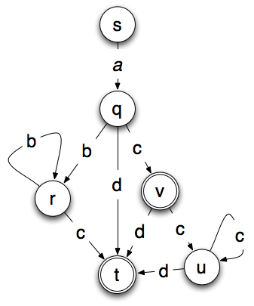
Dthreads Enables…
Race-free Executions
Replay Debugging w/o Logging
Replicated State Machines

Slide 23
Overhead with CoreDet
Dthreads: Efficient Determinism
7.8
Usually faster than the state of the art
Notes:
Highlight when same speed or faster.

Slide 24
Overhead with CoreDet
Dthreads: Efficient Determinism
7.8
Generally as fast
or faster than pthreads
Notes:
Highlight when same speed or faster.

Slide 25
Dthreads: Easy to Use
% g++ myprog.cpp –l thread
p

Slide 26

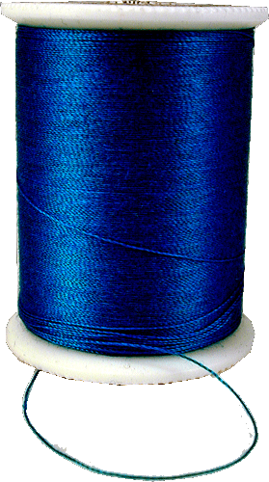
Isolation
shared address space
disjoint address spaces
Notes:
Obviously this doesn’t preserve shared memory semantics, so we need to commit changes made by one thread so they become visible to others.

Slide 27
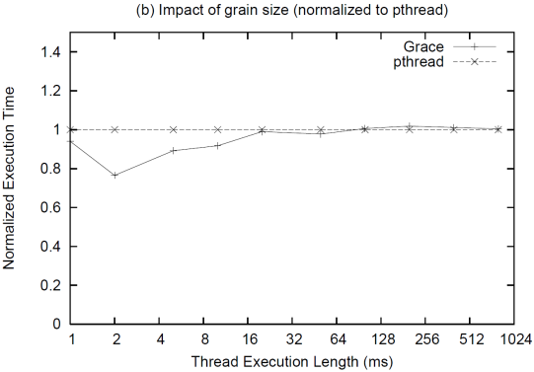
Performance: Processes vs. Threads
1.4
1.2
1.0
0.8
0.6
0.4
0.2
0.0
threads
processes
Normalized Execution Time
1 2 4 8 16 32 64 128 256 512 1024
Thread Execution Time (ms)
Notes:
ADD ANIMATIONS: threads initially on one core then migrating, vs. processes spewed across cores

Slide 28
Performance: Processes vs. Threads
1.4
1.2
1.0
0.8
0.6
0.4
0.2
0.0
threads
processes
Normalized Execution Time
1 2 4 8 16 32 64 128 256 512 1024
Thread Execution Time (ms)
Notes:
ADD ANIMATIONS: threads initially on one core then migrating, vs. processes spewed across cores

Slide 29
Performance: Processes vs. Threads
1.4
1.2
1.0
0.8
0.6
0.4
0.2
0.0
threads
processes
Normalized Execution Time
1 2 4 8 16 32 64 128 256 512 1024
Thread Execution Time (ms)
Notes:
ADD ANIMATIONS: threads initially on one core then migrating, vs. processes spewed across cores

Slide 30
“Shared Memory”

Slide 31

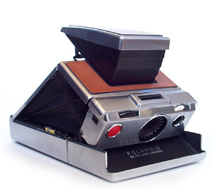
Snapshot pages before modifications
“Shared Memory”

Slide 32

Write back diffs
“Shared Memory”

Slide 33


Update in Deterministic Time & Order
Parallel
Serial
Parallel
mutex_lock
“Thread” 1
cond_wait
“Thread” 2
pthread_create
“Thread” 3

Slide 34

Dthreads performance analysis
Notes:
It’s not *always* as fast or faster than pthreads. Slow THEN HIGHLIGHT THE FASTER PARTS.

Slide 35
The Culprit: False Sharing
Core 1
Core 2
Thread 1
Thread 2
Invalidate
Main Memory
Notes:
Cache coherence protocol makes false sharing problem unpleasant performance effect

Slide 36
The Culprit: False Sharing
Core 1
Core 2
Thread 1
Thread 2
Invalidate
20x
Main Memory

Slide 37
Dthreads: Eliminates False Sharing!
Core 1
Core 2
Process 1
Process 2
Process 1
Process 2
Global State

Slide 38
Dthreads detailed analysis
Dthreads: Detailed Analysis

Slide 39
Dthreads detailed analysis
Dthreads: Detailed Analysis

Slide 40
Dthreads detailed analysis
Dthreads: Detailed Analysis

Slide 41
Scalability
Dthreads: Scalable Determinism

Slide 42
Scalability
Dthreads: Scalable Determinism

Slide 43
Scalability
Dthreads: Scalable Determinism

Slide 44
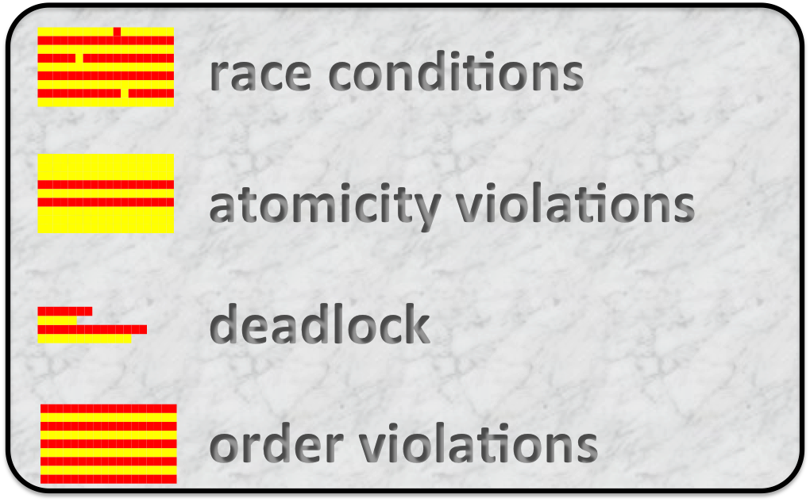

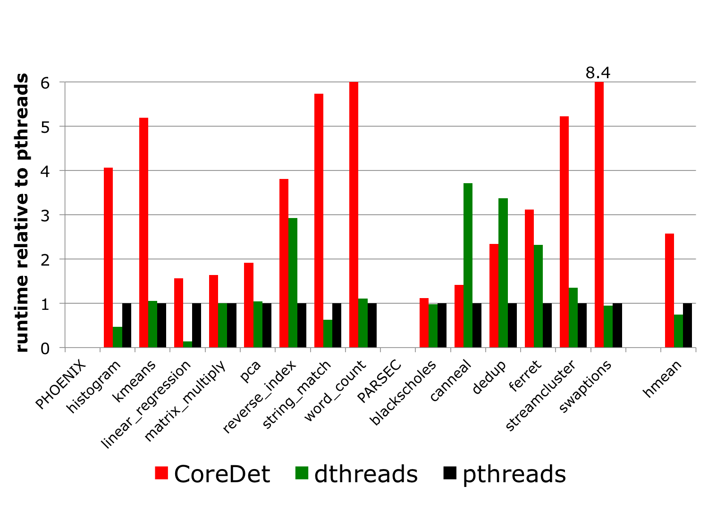
Dthreads
Dthreads
% g++ myprog.cpp –l thread
p
Notes:
Panel 1 = what it does, panel 2 = how, panel 3 = efficient, panel 4 = easy to use

Slide 45
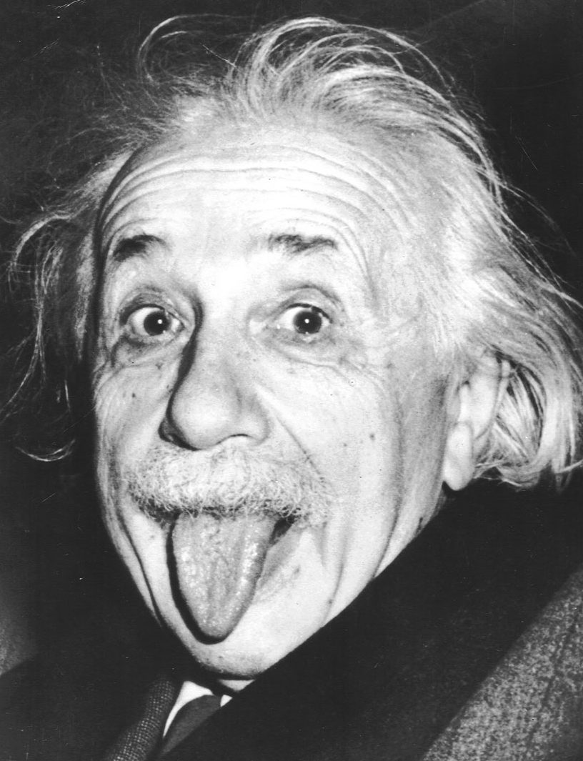
End

Slide 46

Scheduler Determinism
A
a

Slide 47
Excluding Outliers
Dthreads: Without Outliers
Just 5% slower than pthreads
Notes:
Highlight when same speed or faster.

Slide 48
Commit Protocol
Global State
Local
State
Diff
Twin Page
Time

Slide 49
Dthreads Example Execution
a
a
0
1
Global State
b
b
0
1
a
0
a
a
0
1
if(a == 0)
b = 1;
if(b == 0)
a = 1;
b
b
0
1
b
0
a
0
Committed State
b
0
Notes:
Mention commit points
Commit order with token
No description of how isolation works yet

Slide 50
No Problem
a
a
0
1
if(a == 0)
b = 1;
if(b == 0)
a = 1;
b
b
0
1
Notes:
Mention commit points
Commit order with token
No description of isolation yet

Slide 51
That’s Better.
lock();
if(a == 0)
b = 1;
unlock();
a
0
lock();
if(b == 0)
a = 1;
unlock();
b
b
0
1
Notes:
Mention commit points
Commit order with token
No description of isolation yet

Slide 52
Or is it?
lock();
if(a == 0)
b = 1;
unlock();
a
a
0
1
lock();
if(b == 0)
a = 1;
unlock();
b
0
Notes:
Mention commit points
Commit order with token
No description of isolation yet

Slide 53
Determinism
A
a
A
a
Is this enough?
A
a

Slide 54
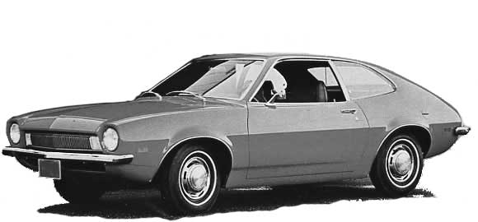
Robust Determinism
A
a
B
b
C

Slide 55
External Nondeterminism
?
socket = open_socket(80);
listen(socket);

Slide 56
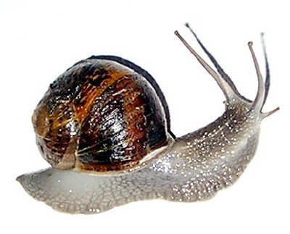
Problem already solved
http://www.gnu.org/s/pth/

Slide 57
Overhead

Slide 58
Wrap-Up
A
a
Determinism
Robust Determinism
?
Internal Determinism

Slide 59
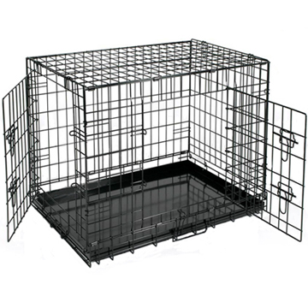

Wrap-Up
Threads to Processes
Commit Before Synch.
Commit In Token Order

Slide 60
Overhead with CoreDet
Performance: Dthreads & CoreDet vs. pthreads
7.8
[ASPLOS 10]

Slide 61
How Dthreads Provides Determinism
Isolation
Deterministic Time
Deterministic Order

Slide 62

Evaluation
Phoenix
http://mapreduce.stanford.edu
http://parsec.cs.princeton.edu

